Slide 1

A mobile streaming solution for IEEE 802.11 infrastructure and mesh networks
Fernando Gros González
09-07-2013

Slide 2
Outline
Introduction
State of the art
Mesh and Manet Networks
Quick Mesh Project
Contribution
Mobile Node Project
New Node in Poblenou Mesh
Mobile Node Android Application
Conclusions
Information sources

Slide 3
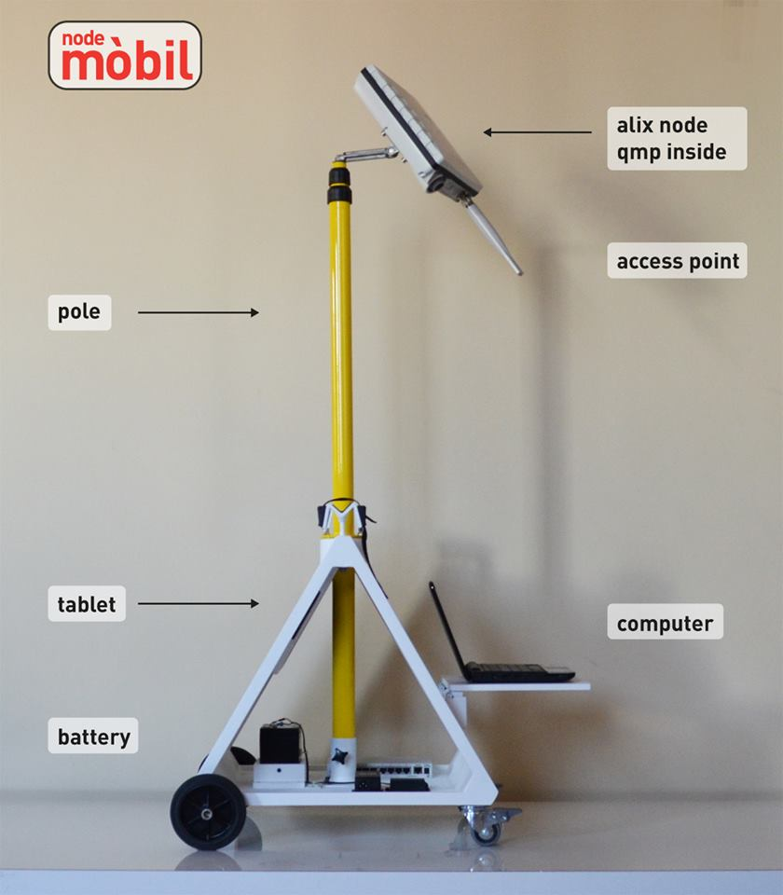
Introduction
The mobile node is a portable and auto-configurable transmission unit with wireless technology that offers mobility in the urban space. This node is designed to contribute to the digital mesh through existing networks.

Slide 4
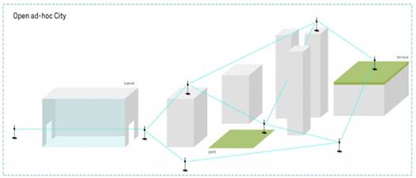
Introduction
Thanks to the low costs of the equipments and to the fact that they are completely self-configuring, it is now possible to model the urban space based on people or communities who are the ones that will be using these infrastructures.

Slide 5
Introduction
Using bottom-up models we try to respond to this necessity by creating a new concept of “social routing” agreed on consensus, with open protocols that provide access to the physical and digital public space. This configuration offers a model with low costs, high social representativeness and ease of reproduction.

Slide 6
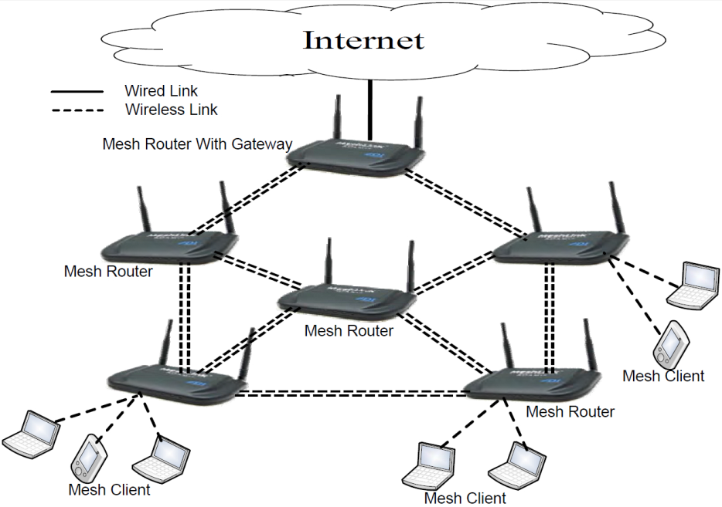
State of the art
Mesh and MANET Networks
A mesh network is one where all the nodes are also routers, they forward their own packets and packets from other nodes according to some pre-established routing rules.
A Wireless Mesh Network (WMN) also refers to the users of the network, the links between nodes are always wireless and we have three different kind of nodes:
Clients
Routers
Gateways

Slide 7
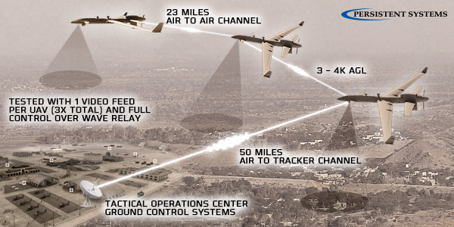
State of the art
Mesh and MANET Networks
Then, a MANET network is a WMN with Mobile devices.
These networks usually have a self-configuring property thanks to the Dynamic Routing Protocols (DRP).

Slide 8

State of the art
Quick Mesh Project
OpenWRT based
802.11a/b/g/n support
IPv6 native
IPv4 tunneled over IPv6
Auto configuration system
Web GUI to monitor and configure
Visualization tools (maps, graphs, etc.)
Automatic dynamic routing (zero-conf)
BGP (Border Gateway Protocol) support (half implemented)
Open Source

Slide 9

State of the art
Quick Deployments
One of the scenarios QMP has been developed for is: Quick deployments.
Achieve the following requirements:
The deployment must be performed as fast as possible.
It must be able to be done by non-technical people.
It must be possible in most situations.

Slide 10
State of the art
Addressing
Qmp uses three different kind of IP addresses:
IPv6 ULA: IPv6 private range to be used internally in the mesh. These IPs are used for the communication among the nodes in the mesh network, and so they are not neither valid nor routable outside.
IPv6 RIPE: IPv6 public IPs range (6to6 tunneling). These are globally valid and routable.
IPv4: IPv4 private range to connect with the final user (4to6 tunneling). They are assigned to the final users attached to a node in the mesh, when they transmit any packet that has to travel throughout the mesh it is encapsulated in an IPv6 packet (tunneling).

Slide 11
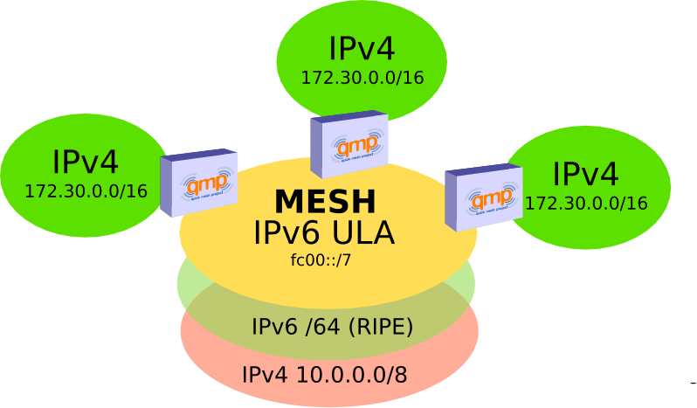
State of the art

Slide 12
State of the art
Modes
Roaming for fast deployments:
All the access points in this mode will have the same IP and the same ESSID in order to allow users mobility, namely, they won’t lose the connection although they switch from an AP to another.
Every AP implements a NAT and so, two users attached to different APs won’t have direct vision between them.
Community:
Every node will have a randomly assigned IPs range and will announce this range through the mesh.
There is not NAT, every user has direct vision with the others (1 hope away from the IPv4 network layer point of view), but mobility is not allowed (no roaming).

Slide 13
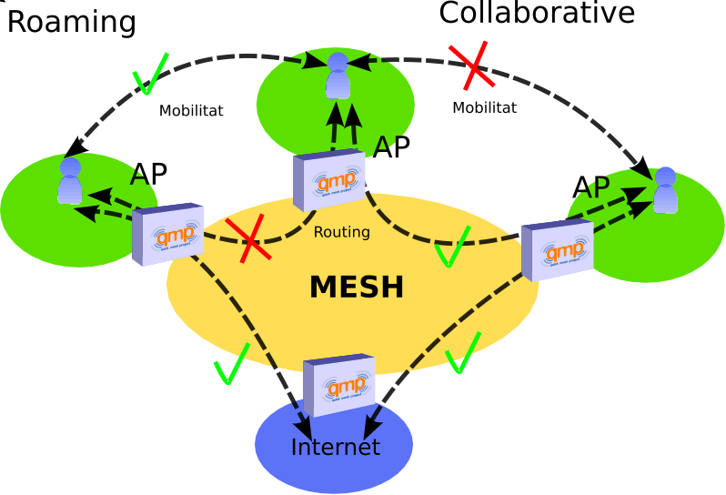
State of the art

Slide 14


State of the art
Dynamic Routing Protocol
The QMP firmware, uses the following protocols:
BMX6 as the main DRP.
OLSR6 as a backup DRP.
Babel as a backup DRP but optional.
All three use IPv6 ULA to talk to other nodes and are isolated at the link layer (MAC) using VLANs.

Slide 15
State of the art
BMX6
Pro-active: Uses UDP flooding to periodically send Originator Messages (OGM) and build a routing table.
Destination-sequenced, Distance-vector (DSDV): Every node just knows which neighbor is better to reach another, namely, they do not need to know the entire topology, just the best paths.
Does not use IP as node identifier, it uses global identifiers using SHA2 hashing.

Slide 16
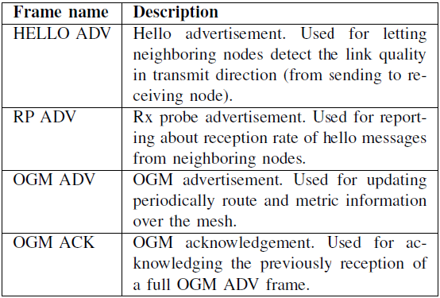
State of the art

Slide 17
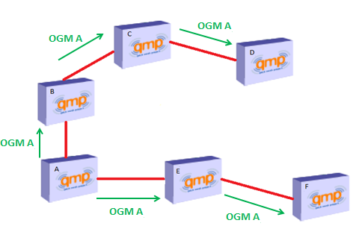
Best Path to A
Step | B | C | E | D | F
1 | A | - | A | - | -
2 | A | B | A | - | E
3 | A | B | A | C | E

Slide 18
Contribution
Mobile Node Project
“The Mobile Node is an independent transmission unit made up of open protocols; it is a device with its natural space in the urban environment, which enables a digital fabric to be created using wireless networks. The project has become a process of constant research and development which explores the possibilities of interactivity in the digital public space.” (Extracted from Sonar project presentation)
We are combining hardware and firmware and using the resulting device in a different way.

Slide 19
Contribution
Mobile Node Project
The most common usage will be as a temporary solution to cover a particular zone during a certain period of time. It can be very useful in events, congresses, concerts, parties, etc.
Using this device in cities like Barcelona, where fixed mesh networks are quite extended, will allow the organizers of the events to provide Internet Access to the attendants in a very fast, easy and cheap manner.
But, this is not the only way to use it!!

Slide 20
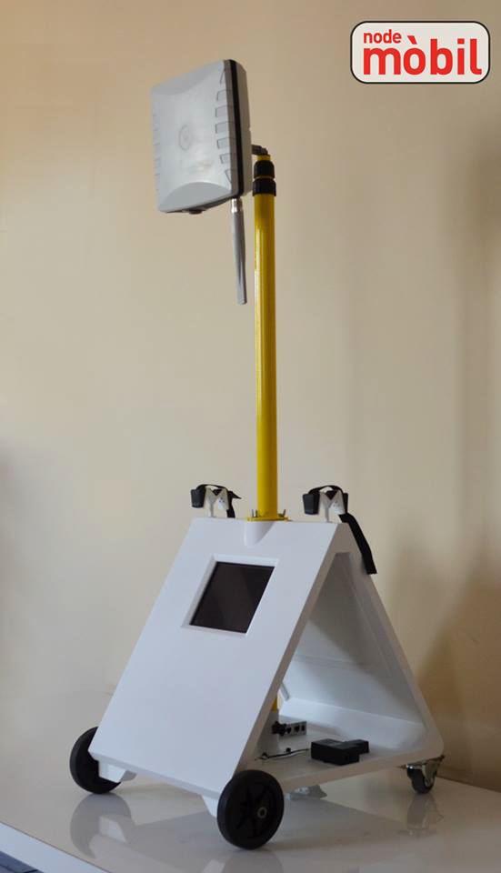
Contribution
Latest prototype designed
and presented in 2013
Sonar+D event in Barcelona

Slide 21
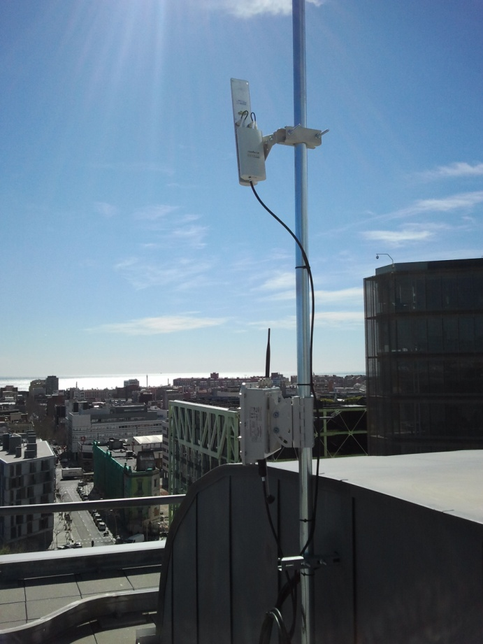
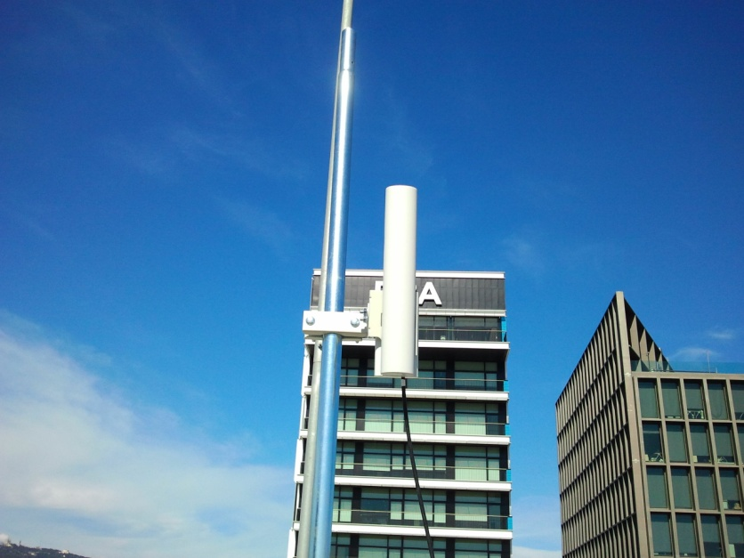
Contribution
New node in Poblenou Mesh
We have contributed this new Mesh network which is currently being deployed by installing a node on the roof of Roc Boronat building.

Slide 22
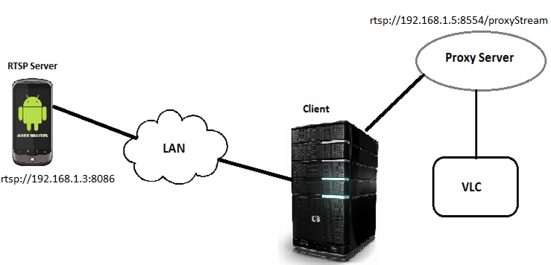
Contribution
Mobile Node Android Application
The mobile node Android application basically sends a video stream from the smartphone to any client in the same network. This video is captured from the phone camera and transmitted using RTSP (Real-Time-Streaming-Protocol).

Slide 23
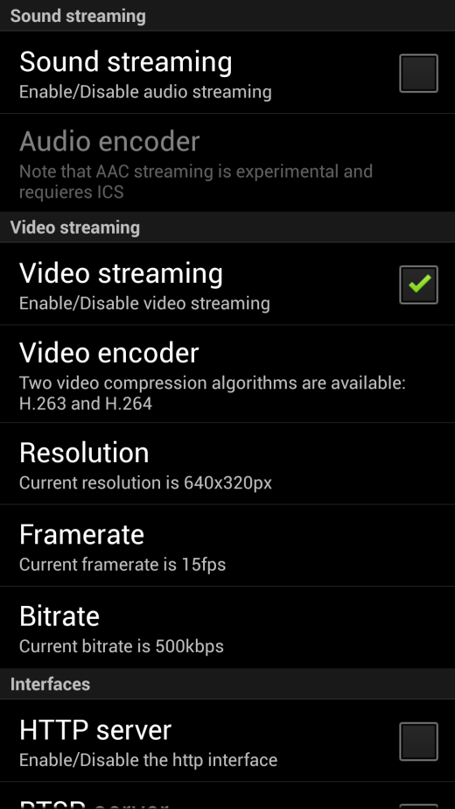
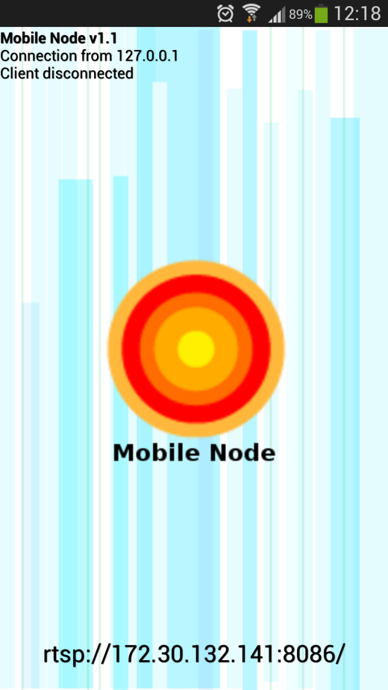
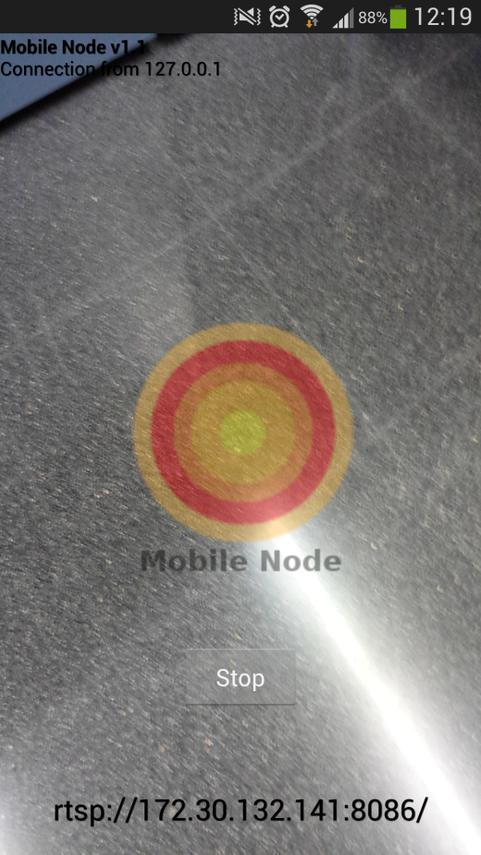
Contribution
Mobile Node Android Application

Slide 24
Contribution
Mobile Node Android Application
DEMO

Slide 25
Conclusions
The most important feature of this field could be that mesh networks can be open or not, can run application over them or not, can use a any compatible hardware and in any imaginable way. So, all the topics studied can work together or independently.
The networks being deployed follow a Bottom-up model and their model is successful in most cases, with just some point to improve.
Making these networks grow in different ways is a very important point.

Slide 26
Conclusions
Mobile Node and Mobile node app are some examples of how to make a network grow and improve its services.
In the end, we can say that all the initiatives studied try to improve the way we communicate nowadays.

Slide 27
Information Sources
Escrich, P. (2012, January). Quick deployment network using MANET. Retrieved March 4, 2013
Escrich, P. (2012, November 17). Xarxes Mesh. Curs Guifi.net 2012. Retrieved March 5, 2013
Mobile ad hoc network. (n.d.). In Wikipedia. Retrieved March 4, 2013, from http://en.wikipedia.org/wiki/Mobile_ad_hoc_network
Starting a Community. (2013, January 11). In Quick Mesh Project. Retrieved March 5, 2013, from http://qmp.cat/projects/qmp/wiki/Starting
Roaming-Community/Collaborative. (2012, June 26). In Quick Mesh Project. Retrieved March 5, 2013, from http://qmp.cat/projects/qmp/wiki/Roaming-Collaborative

Slide 28
Information Sources
Foglia, E. (2010). Mobile Node: Open Portable Infrastructure, Overlapping Digital Paths. MediaCity: Interaction of Architecture, Media and Social Phenomena., pages 557–570.
Neumann, A., Lopez, E., and Navarro, L. (2012). An evaluation of bmx6 for community wireless networks. International Workshop on Community Networks and Bottom-up-Broadband (CNBuB 2012).

